Slide 1

Please delete this sheet before submitting

Slide 2

WORK BREAKDOWN STRUCTURE –
IP25 Live Project Deliverables–
‘Software Development’
Create an
‘ML PREDICTION SYSTEM’
as per Industry Ways of Working
INITIATION
Project Charter
SRS Document
PLANNING
WBS
Project Schedule
RAID Logs
EXECUTION & MONITORING
CLOSURE
Lessons Learnt, Project Report
Design
Develop
Test
Deploy
Design Specification
Code
Test Report
Test Results
App Video,
Installation Guide
Data Preprocessing + Cleaning
Missing Label Handling
SMOTE + Final XGBoost Training
Accuracy, Precision, Recall, F1 Evaluation
Dataset Study
EDA + Feature Selection
Model Design (XGBoost pipeline)

Slide 3

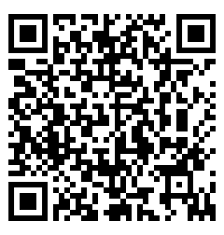
Our Contact
Please delete this sheet before submitting
Member@IndustryAcademiaCommunity.com
You may even raise queries in the Q&A section of your respective domain community on the IAC platform

